Slide 1

An introduction to digital design
Purpose/Process/Participation

Slide 2
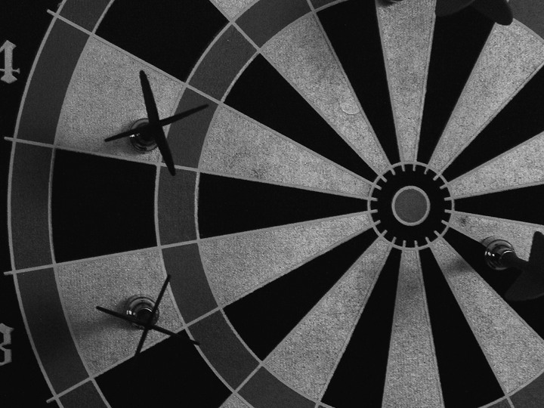
goals
• help capco employees understand the process of creating digital products and services
• highlight what user-centered design means
• show how digital design fits into the capco organization and client engagements

Slide 3

capco and design
• why is capco needed in the design process?
• financial institutions are being forced to focus on enhancing the customer’s experience
-this is primarily being forced by massive shifts in customer expectations of products and services
• these institutions are having struggles with evolving the customer experience ecosystem
• they come to us to help them envision a future and then enact it through the design process

Slide 4
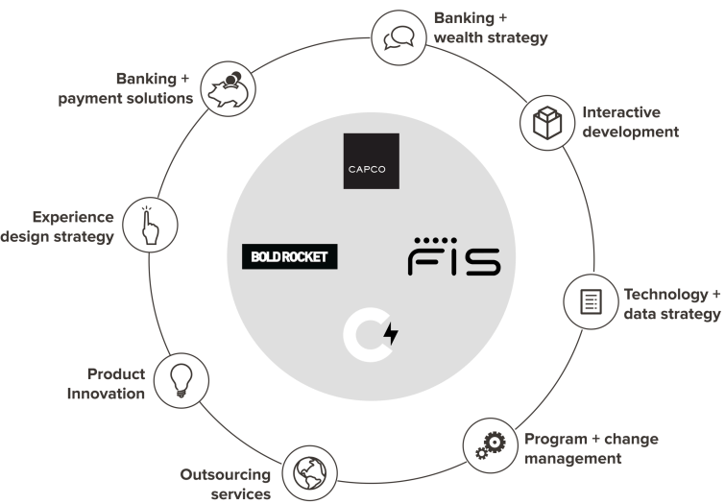
open concept
• unified capabilities
• companies can co-exist under one umbrella: same thoughts, same passions, one goal

Slide 5

product design
• individual projects and initiatives with the goal of rolling up into a larger program
• helps define brand and user experience consistency
case study: apple products

Slide 6

touch points
• personal computers
• smart phones
• cell phones
• tablets
• game consoles
• wearables
- enhance existing products and create new ones

Slide 7

design thinking
• design specific cognitive activities that designers apply during the process of designing
• match users needs with business strategy and technical capabilities
• relationship between cognitive psychology (thinking processes) and computer science

Slide 8

user-centered design
circular pattern of
• research
• define
• design
• adapt
• measure

Slide 9
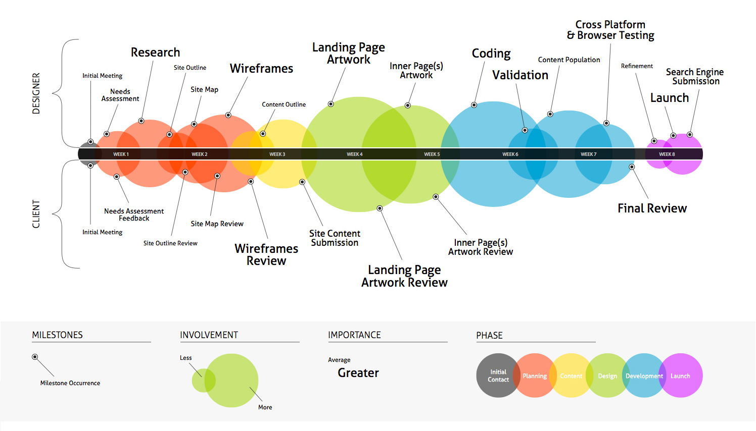
design process
• consistent and dynamic conversation between multiple layers

Slide 10

design process players
• user experience strategy
• user experience research and testing
• visual design
• user experience design
• user interface developers
• digital marketing and social media

Slide 11
digital strategy
• what is it?
an approach/formula that guides the use of resources to transform the current state of an application to a future desired state
Invokes a long-term vision, roadmap and key performance indicators to align all user involvement with the brand positioning and business strategy
• why is it done?
Increase sales and marketability
Build brand awareness
Gets entire team to buy into the user experience
Reduces time spent building components that don’t contribute to business value
• key activities
tracks and discovers customer trends
researches new technologies/innovations
• what are deliverables?
Defined, strategic written document
• how does the development strategy team integrate?
  Works with the business, visual designers and user experience designers to implement a successful and strategic product

Slide 12

exercise:
• our overall game plan is to be come (blank)
• in practice for our user experience, this means (3 statements)
• this application will align with our business requirements by (3 statements)
• this application will meet the deepest needs of customers by (3 statements)
• this application will differentiate from competitors by (3 statements)
• we will know it works when (3 statements)

Slide 13
user experience research & testing
• what is it?
focuses on understanding user behaviors, needs and motivations through observation techniques, task analysis and other feedback methodology
• why is it done?
protects from designing the wrong product: one that will not be used or one that provides a poor quality of use
saves from using too much time and/or money producing a product
removes assumptions from the design process
• key activities
card sorting - contextual and/or individual interviews
first click testing - focus groups and testing
heuristic evaluation - prototyping reporting
• what are deliverables?
Testing results
Personas and use cases
• how does the development strategy team integrate?
  Works directly with the user experience designers to ensure best user experience principles are used. Works directly with the user interface developers to provide updates as needed.

Slide 14
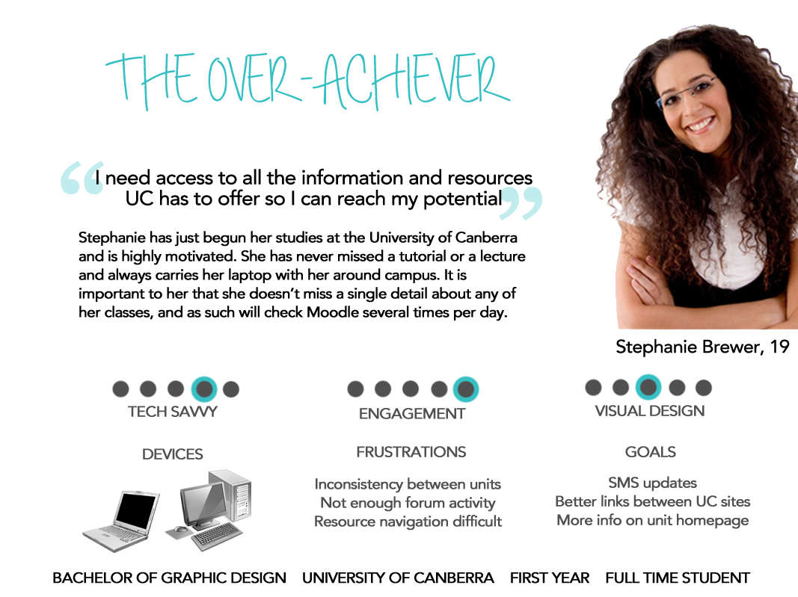

Slide 15
visual design
• what is it?
the method of visual communication and problem solving through the use of type, space and image
focuses on the aesthetics of a site and its related materials by strategically implementing images, colors, fonts and other elements to create a visual representation of ideas and messages
• why is it done?
enhances transfer of knowledge and visual messages
readability and legibility is enhanced by improving visual presentation
aid in selling products through effective visual communication
provide a way to communicate information quickly and economically through a color or a symbol
• key activities
define visual guidelines such as typography, colors, textures, margins and gutters, images and icons
• what are deliverables?
mood boards and style guide
visual design comps
• how does the development strategy team integrate?
  works with business team to establish and /or enhance overall branding

Slide 16
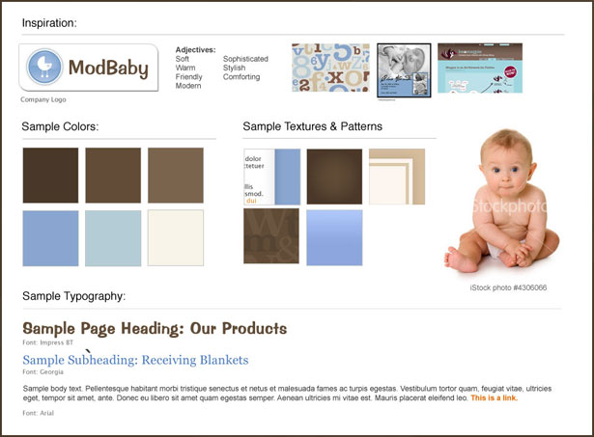

Slide 17
user experience design
• what is it?
(UXD or UED) is the process of enhancing customer satisfaction and loyalty by improving the usability, ease of use and pleasure provided in the interaction between the customer and the product
encompasses traditional human-computer interaction (HCI) design, and extends it by addressing all aspects of a product or service as perceived by users
• why is it done?
integrated into software development and other forms of application development to inform feature requirements and interaction plans based upon the user’s goals
  helps avoid unnecessary product features
  improves the usability of the system and therefore its acceptance by customers
  expedites the design and development through detailed and properly conceived guidelines
  incorporates business and marketing goals while protecting the user’s freedom of choice
• key activities
gathering business requirements in order to provide deliverables
• what are deliverables?
site map, storyboard and user flows
wireframes and prototype (paper or digital)
• how does the development strategy team integrate?
Act as glue between the business and development teams to establish solid structure of communication

Slide 18
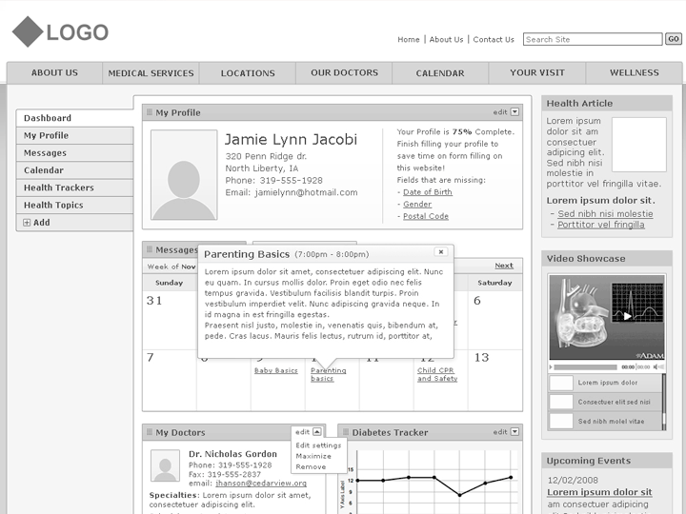

Slide 19
user interface development
• what is it?
the build of user interfaces that supports the build of information between an application’s users and its back-end processes and databases
• why is it done?
to provide a visual interface for the users to interact with
provide a display of information pulled from the back-end
provide user interface back practices through using the latest technology
• key activities
programming through a multitude of programming languages such as HTML, CSS and JavaScript
• what are deliverables?
functional, testable, shippable code that lets users accomplish their goals when using an application
• how does the development strategy team integrate?
works with user experience team and back-end developers in providing an interactive application

Slide 20
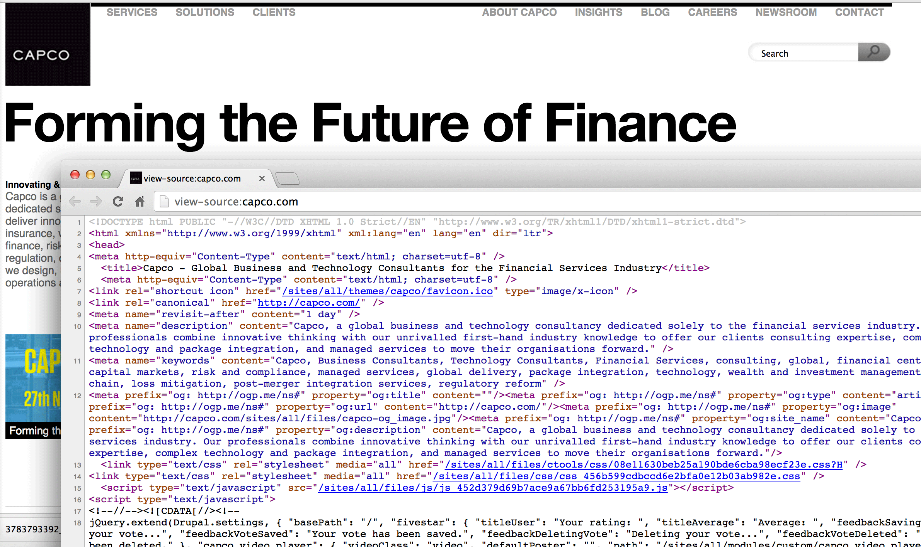

Slide 21
digital marketing and social media
• what is it?
marketing that makes sense of electronic devices to engage with stakeholders
differs from traditional marketing by using channels and methods that enable an organization to analyze marketing campaigns and to understand what is working and what isn’t in real time
• why is it done?
to provide access of information anytime and any place
manage complex customer relationships across a variety of channels
responds to and initiates dynamic customer interactions
extracts values from big data to make better decisions faster
• key activities
market and statistical research and comparison
• what are deliverables?
advertisements - blog
SEO key words - web analytics
• how does the development strategy team integrate?
works directly with the digital and marketing strategy teams to increase profit and revenue

Slide 22
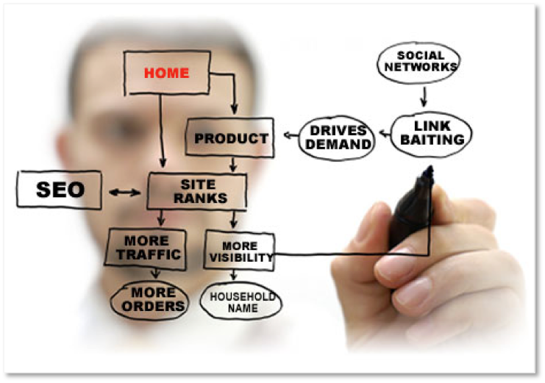

Slide 23

How consultants and designers work together

Slide 24
potential opportunities for collaboration

Slide 25
digital skills you can learn
• research
Morae software/Camtasia
quick prototyping tools (Axure/Balsamiq/iRise)
Google analytics
• visual design
Adobe Creative Suite
drawing
• user experience design
Omnigraffle/Visio
Fireworks
• user interface development
HTML
CSS
JavaScript

